Slide 1

Department of Industrial Engineering College of Engineering Guindy, Anna University Food-Grain Classification and Supply-Chain Forecasting for Food Corporation of India (Govt. of India)
Under the guidance of Prof.(Dr.) Rajmohan M.
Harshan H (2017108015)
Mohammed Suhail S (2017108024)
Neelesh K (2017108025)
Debaroon Mitra (2017108056)

Slide 2
Literature Review
[1] Choney Zangmo and Montip Tiensuwan (2018), Application of logistic regression models to cancer patients: a case study of datafrom National Referral Hospital (JDWNRH) in Bhutan - Journal of Physics: Conference Series, Volume 1039, 2018 8th International Conference on Applied Physics and Mathematics (ICAPM 2018) 27–29 January 2018, Phuket, Thailand
[2] Erkan Ari, Noyan Aydin (2016), Examination by Multinomial Logistic Regression Model ofthe Factors Affecting The Types Of Domestic Violence against Women: A Case Of Turkey - International Journal Of Scientific & Technology Research Volume 5, Issue 11, November 2016
[3] Jun Wu, Anastasiya Olesnikova, Chi-Hwa Song (2009), The Development and Application of Decision Tree for Agriculture Data - Second International Symposium on Intelligent Information Technology and Security Informatics
[4] Khalid Khan, Gulawar Khan, Sarfaraz Ahmed Shaikh, Abdul Salem Lodhi and GhulamJilani (2015), ARIMA Modelling for Forecasting of Rice Production: A Case Study of Pakistan - U. J.Sci. Techl. vol.IV, pp. 117-120, 2015, 117 ISSN 2306-8256 Lasbela
[5] Margaretha Ohyvera, Herena Pudjihastut (2018), ARIMA Model for Forecasting the Price of Medium Quality Rice to AnticipatePrice Fluctuations -3rd International Conference on Computer Science and Computational Intelligence 2018
[6] Mehmet Sahin, Rızvan Erol (2017), A Comparative Study of Neural Networks and ANFIS for Forecasting AttendanceRate of Soccer Games -Math. Comput. Appl. 2017, 22, 43; doi: 10.3390/mca22040043 www.mdpi.com/journal/mca
[7] Suhail M. Odeh (2011), Using an adaptive neuro-fuzzy inference system (ANFIS) algorithm for automaticdiagnosis of skin cancer - European, Mediterranean & Middle Eastern Conference on Information Systems
[8] Surabhi Chouhan, Divakar Singh, Anju Singh (2016), An Improved Feature Selection and Classification using Decision Tree for Crop Datasets - International Journal of Computer Applications (0975 – 8887) Volume 142 – No.13, May 2016

Slide 3
Problem Statement:
To build machine learning and deep learning models to classify the food grains into four categories (A, B, C, D) based on the feature values.
To forecast the quantity of food-grains to be received from Madhya Pradesh by Food Corporation of India in Tamil Nadu during January 2021

Slide 4
Machine Learning Algorithms used
Deep Learning Parameters used
Algorithm
Logistic Regression
Decision Tree Algorithm
Support Vector Machine
Activation Functions | Optimizers
Rectified Linear Unit | Stochastic Gradient Descent
Hyperbolic Tangent | Adaptive Moment Estimation
Sigmoid function | Adaptive Gradient Descent
Two-factor ANOVA was performed to study the main effects and the interaction effect of activation function & optimizer on the algorithm’s accuracy.
One-factor ANOVA was performed to find out whether the accuracy of an algorithm is constant for all iterations.
 | Trial: 1 | Trial : 2 | Trial : 3 | Mean
Decision Tree Algorithm | 0.98 | 0.97 | 0.96 | 0.97
Support Vector Machine | 0.86 | 0.72 | 0.89 | 0.82
Logistic Regression | 0.78 | 0.81 | 0.85 | 0.81
 | Adam | SGD | Adagrad
ReLu | 98.077 | 41.346 | 47.115
 | 96.154 | 50.000 | 56.731
Tanh | 90.385 | 50.962 | 47.115
 | 97.115 | 59.615 | 57.692
Sigmoid | 83.654 | 58.654 | 44.231
 | 79.808 | 45.192 | 51.923
Activation Function
From the above table, Decision Tree algorithm performed
the best for this data with 97% accuracy (mean)
From the above table, the deep learning model performs best (97.2% accuracy) with ReLu as activation function and Adam optimizer

Slide 5
Single Factor Factorial Experiment on Machine Learning Algorithms
Logistic Regression
H_{0:} The accuracy of an algorithm is constant for all trials.
H_{1:} The accuracy of an algorithm is not constant for all trials.
 | A | B | C | D
A | 18 | 3 | 1 | 0
B | 7 | 12 | 3 | 1
C | 0 | 3 | 29 | 4
D | 0 | 0 | 0 | 23
Support Vector Machines
Source of variation | Sum of Squares | Degrees of freedom | Mean square | F₀
Groups | 0.050469556 | 2 | 0.025234778 | 7.978955
Error | 0.018976 | 6 | 0.003162667
Total | 0.069445556 | 8
PREDICTED
 | A | B | C | D
A | 24 | 1 | 0 | 1
B | 6 | 23 | 0 | 0
C | 0 | 1 | 30 | 3
D | 0 | 0 | 2 | 39
ACTUAL
Accuracy = 0.788
Decision Tree Algorithm
Tabulated value : F_{5%, 2, 6} = 19.33
INFERENCE:
Since F_{0.05, 2, 6} is greater than F₀, the null hypothesis is not rejected.
The null hypothesis is accepted.
The accuracy of any algorithm is constant for all trials.
 | A | B | C | D
A | 22 | 0 | 0 | 0
B | 0 | 23 | 0 | 0
C | 0 | 0 | 34 | 2
D | 0 | 0 | 0 | 23
Accuracy = 0.89
Accuracy score = TP / Total Samples
= 92 / 104
= 0.89
Accuracy = 0.981

Slide 6
Two Factor Factorial Experiment on Deep Learning Parameters
Source of Variation | Sum of Squares | Degrees of freedom | Mean Squares | F₀
Optimizer | 6395.011456 | 2 | 3197.505728 | 87.432375
Activation function | 133.8481181 | 2 | 66.92405906 | 1.8299668
Activation x Optimizer | 245.5211622 | 4 | 61.38029056 | 1.6783784
Error | 329.1406815 | 9 | 36.57118683
Total | 7103.521418 | 17
F- value for between columns:
F (2,4) at 0.05 level of significance = 4.26
Calculated F_{C} = 87.432375
Since Calculated F_{C} > 4.26
H₀ rejected, hence there is significant differentiating between columns.
The main effects of Optimizer is significant.
2. F- value for between rows:
F (2,4) at 0.05 level of significance = 4.26
Calculated F_{R} = 1.8299668
Since Calculated F_{R} < 4.26
H₀ accepted, hence there is no significant differentiating between rows.
The main effects of Activation function is not significant.
3. F-value for between rows & columns:
F (2,9) at 0.05 level of significance = 3.63
Calculated F_{RxC} = 1.6783784
Since Calculated F_{RxC} < 3.63
H₀ accepted, hence there is no significant differentiating between rows and columns.
The interaction effects are not significant.

Slide 7
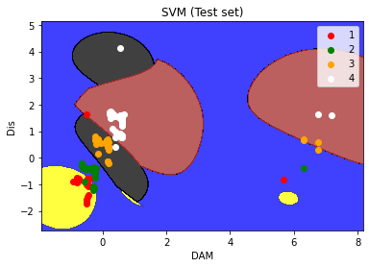
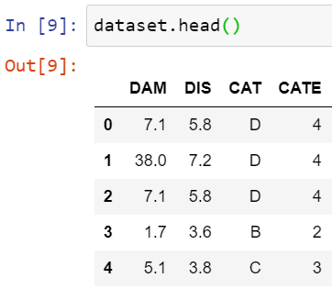
SUPPORT VECTOR MACHINE
“Support Vector Machine” (SVM) is a supervised machine learning algorithm which can be used for both classification or regression challenges”
PROBLEM STATEMENT:
Kernel | Accuracy
LINEAR | 0.86
POLYNOMIAL | 0.72
RBF | 0.89
Classification of food grains based on features namely ‘damaged’ and ‘discoloured’.
ALGORITHM:
The SVM algorithm is deployed using JUPYTER NOTEBOOK OF ANACONDA(PYTHON).
Best SVM kernel:
DATASET:
CONFUSION MATRIX:
PREDICTED
1 | 2 | 3 | 4
1
2
3
4
24 | 1 | 0 | 1
6 | 23 | 0 | 0
0 | 1 | 30 | 3
0 | 0 | 2 | 39
ACTUAL
ACCURACY: 0.89
RbF kernel

Slide 8
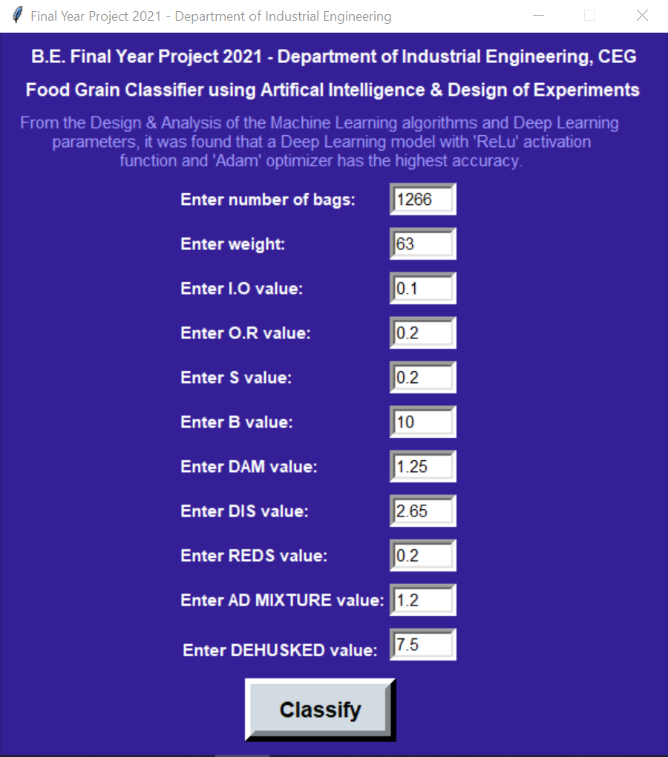
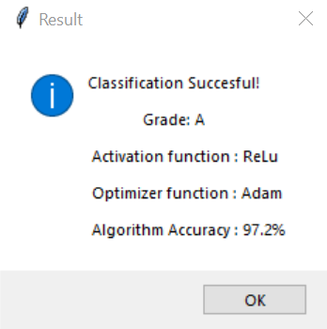
Model Deployment
Output
Python Application's User Interface

Slide 9
PREDICTION ALGORITHMS
ARIMA: Auto Regressive Integrated Moving Average
LSTM: Long Short Term Memory
GRU: Gated Recurrent Unit
Neural Prophet
XG Boost
Data Description: Quantity of food grain(in MTs ) received by Tamil Nadu From Madhya Pradesh during the time period JANUARY 2020 to DECEMBER 2020.
PROBLEM STATEMENT: To predict the quantity of food grain (in MTs) received by Tamil Nadu From Madya Pradesh during the JANUARY 2021

Slide 10
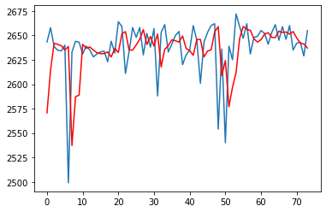
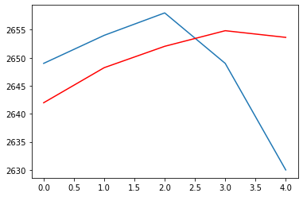
ARIMA : Auto Regressive Integrated Moving Average
ARIMA, short for ‘Auto Regressive Integrated Moving Average’, is a forecasting algorithm based on the idea that the information in the past values of the time series can alone be used to predict the future values.
PROBLEM STATEMENT: To create an ARIMA model to predict the rakes received from MADHYA PRADESH to TAMIL NADU
ALGORITHM : The ARIMA algorithm is deployed using JUPYTER NOTEBOOK OF ANACONDA(PYTHON).
After grid searching for parameters of the ARIMA model it is found out that the best ARIMA model was (2,1,0) with a Root mean squared error of 11.125 and Mean Absolute Error of 9.30
----------- = Actual
----------- = Predicted
Date | Actual | Predicted
01-01-2021 | 2649 | 2641.9
06-01-2021 | 2654 | 2648.23
11-01-2021 | 2658 | 2652.04
16-01-2021 | 2649 | 2654.82
21-01-2021 | 2630 | 2653.636
Fitted model
Forecast model

Slide 11
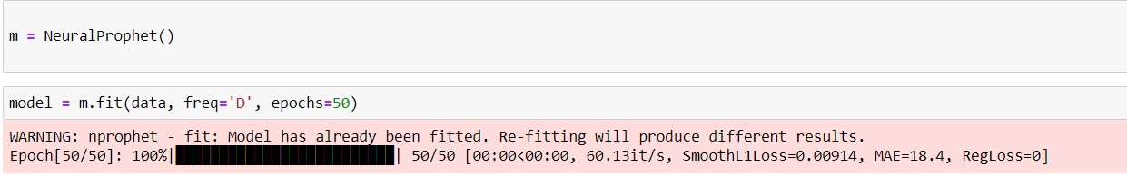
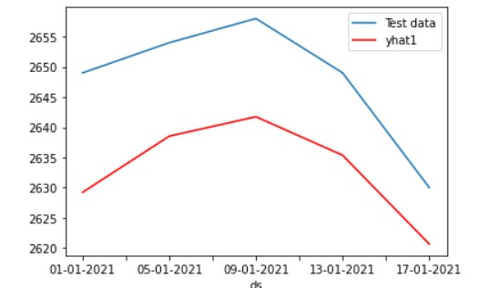
Neural Prophet
A Neural Network based Time-Series model, inspired by Facebook Prophet and AR-Net, built on PyTorch. Instead of just using values at previous time stamps, the model applies Fourier series to the input
PROBLEM STATEMENT: To create an Neural Prophet model to predict the rakes received from MADHYA PRADESH to TAMIL NADU
ALGORITHM : The Neural Prophet algorithm is deployed using JUPYTER NOTEBOOK OF ANACONDA(PYTHON).
Predicted Vs Test data
Date | Actual | Predicted
01-01-2021 | 2649 | 2629.9
05-01-2021 | 2654 | 2638.23
9-01-2021 | 2658 | 2641.04
13-01-2021 | 2649 | 2635.82
17-01-2021 | 2630 | 2620.636
----------- = Actual
----------- = Predicted

Slide 12
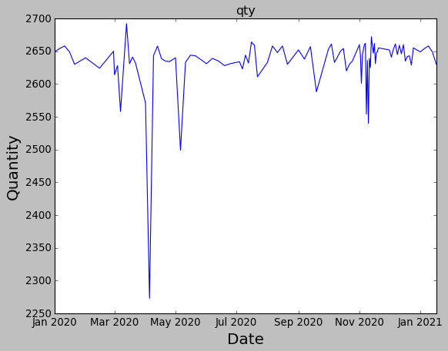
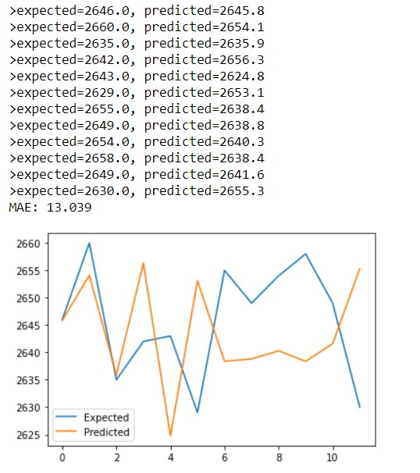
XG Boost
XGBoost is a decision-tree-based ensemble Machine Learning algorithm that uses a gradient boosting framework. In prediction problems involving unstructured data (images, text, etc.) artificial neural networks tend to outperform all other algorithms or frameworks.
PROBLEM STATEMENT: To create an XG Boost model to predict the rakes received from MADHYA PRADESH to TAMIL NADU
ALGORITHM : The XG Booster algorithm is deployed using JUPYTER NOTEBOOK OF ANACONDA(PYTHON).
Given Data
Forecast model

Slide 13
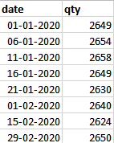
LSTM(Long Short Term Memory)
LSTM is a type of RNN (Recurrent Neural Network) having feedback connections. A LSTM unit is composed of a cell, an input gate , an output gate and a forget gate.
The model used has 3 LSTM layers with 70 neurons each, 2 Dropout Layers and 1 Dense Layer.
Prediction of Rakes:
Data:

Slide 14
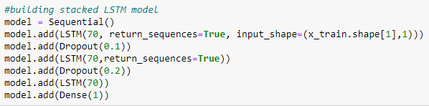
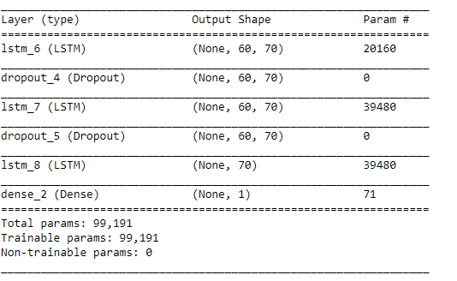
Model:

Slide 15
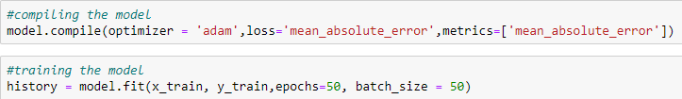
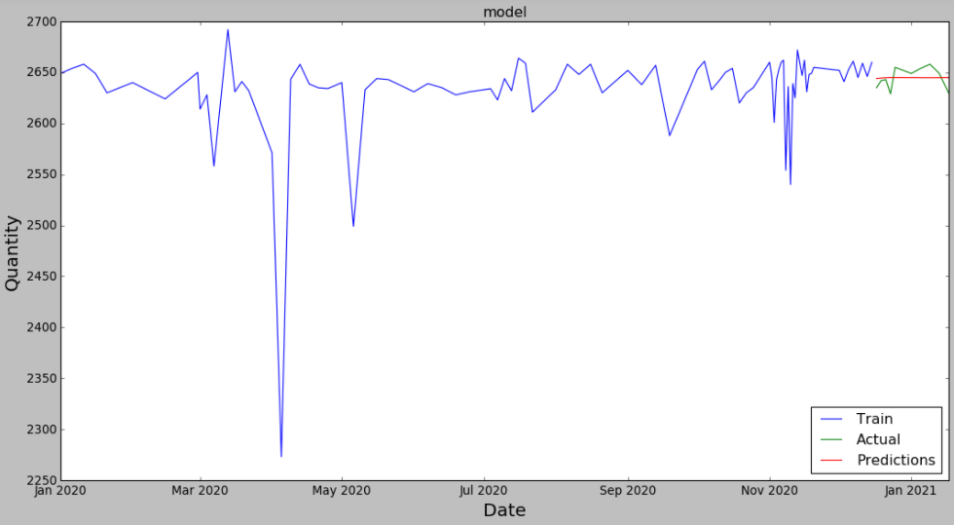

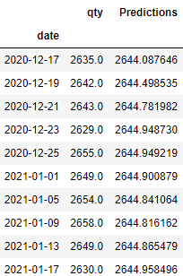
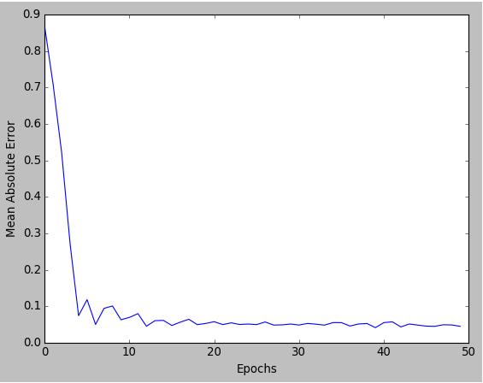
Parameter 1(Adam Optimizer)
Prediction

Slide 16
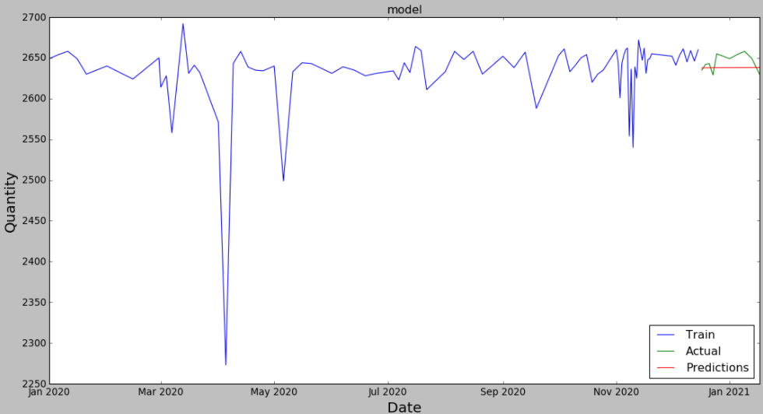

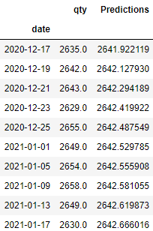
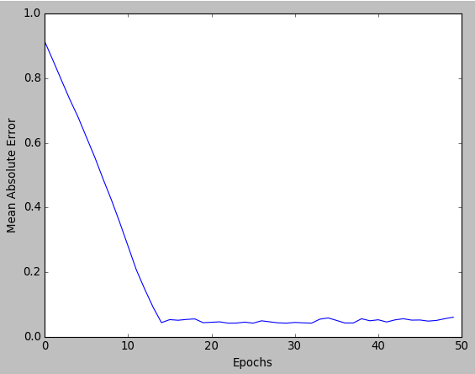
Parameter 2(SGD Optimizer)
Prediction:

Slide 17
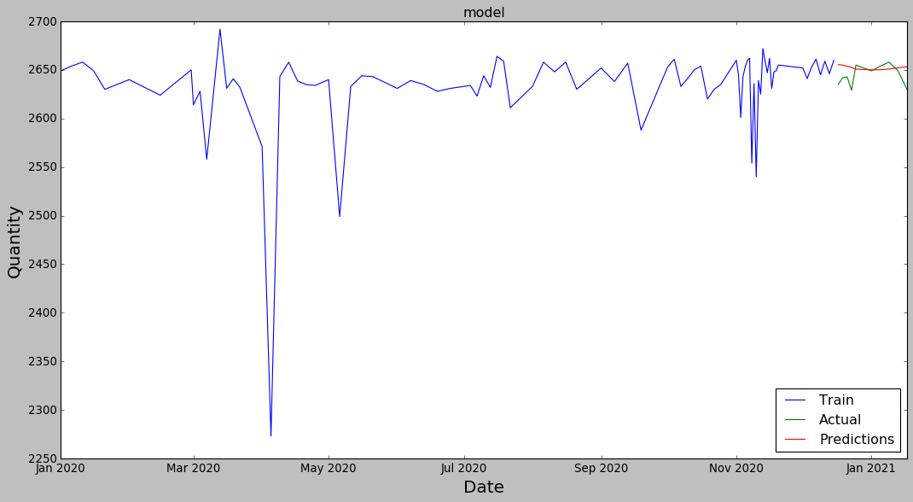
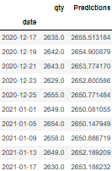

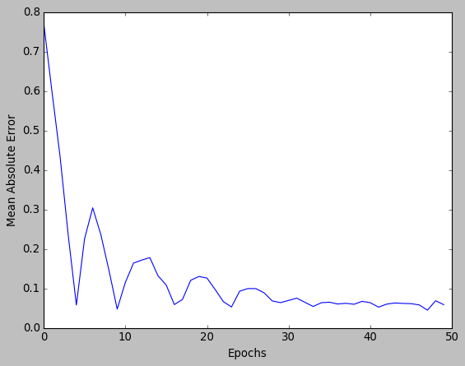
GRU(Gated Recurrent Unit)
GRU is a type of RNN algorithm. It is similar to LSTM but does not have a forget gate and output gate.
PROBLEM STATEMENT: To create a GRU model to predict the rakes received from MADHYA PRADESH to TAMIL NADU
ALGORITHM : The GRU algorithm is deployed using JUPYTER NOTEBOOK OF ANACONDA(PYTHON).

Slide 18
Conclusion:
For the prediction problem out of 5 algorithms, it was found that the LSTM model with Tanh activation function and Adam optimizer performed best with an MAE of 8.41.
For the classification problem out of 4 algorithms, The Neural Network model with ReLu activation function and Adam optimizer performed best with an accuracy of 97.2%.
From the results of single factor factorial experiments, it can be concluded that the accuracy of any algorithm is constant for all trials.
From the results of two factor factorial experiments, it can be concluded that that the main effects of the activation function and the interaction effect are not significant. However, the main effect of the Optimizer is significant.

